Slide 1


ORVBA
On Road Vehicle Breakdown Assistance
Mohammed Aasim Hussain – 160420737112
Mohammed Faizuddin – 160420737115
Taufeeq Hussain – 160420737116

Slide 2



Abstract
The On-Road Vehicle Breakdown Assistance (ORVBA) system provides reliable support for individuals facing mechanical issues in remote locations. With approved mechanics, transparent pricing, and user feedback, ORVBA ensures trustworthy service, offering peace of mind to registered users.

Slide 3
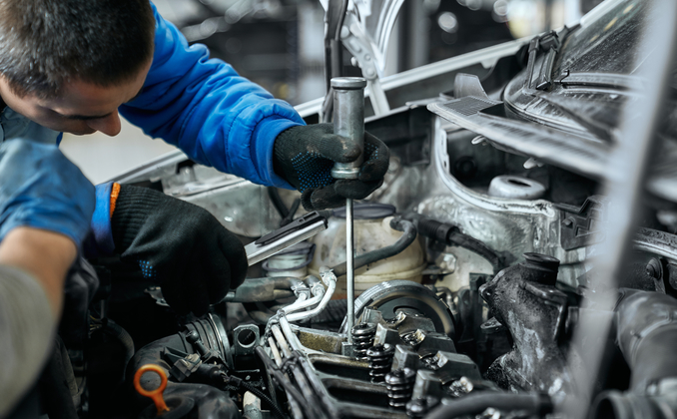
Existing System:
Stranded motorists face various challenges, including:
Safety concerns
Inconvenience and stress
Limited assistance options
Time-consuming process

Slide 4
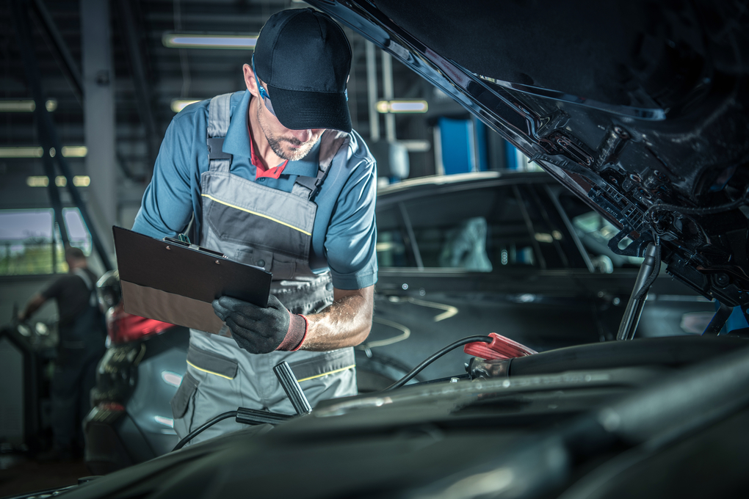
Proposed System:
The Need for Reliable On-Road Vehicle Breakdown Assistance:
A reliable breakdown assistance service can:
Provide peace of mind
Convenience and Accessibility
Ensure Safety and Security
Enhance customer experience

Slide 5

Key Features
Quick Assistance Request
Customer Support
24/7 Availability
Fast Response Time
Comprehensive Service Coverage
User-Friendly Interface

Slide 6
Roadside Assistance:
Roadside Assistance
Jump starts
Dent Repairs
Painting
Flat Tire Changes
Accidental Repairs
Towing Service
Minor Repairs
Electrical Issues

Slide 7
Types Of Users
Users
Customer
Mechanic
Admin

Slide 8
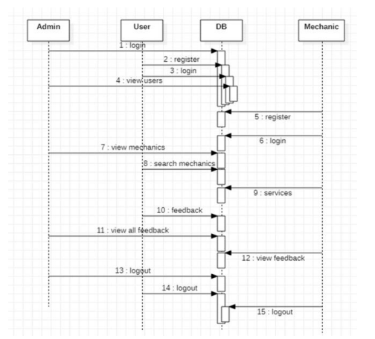
Website Working Sequence

Slide 9
Front-End
TechStack:
HTML,CSS,JS, Bootstrap
Back-End
TechStack:
Php, AngularJS, MySQL
XAMPP
(Apache & MySQL)
User
Localhost
Failed
start
System Architecture
Server
HTTP Post/Get
Web Browser
JSON Response

Slide 10
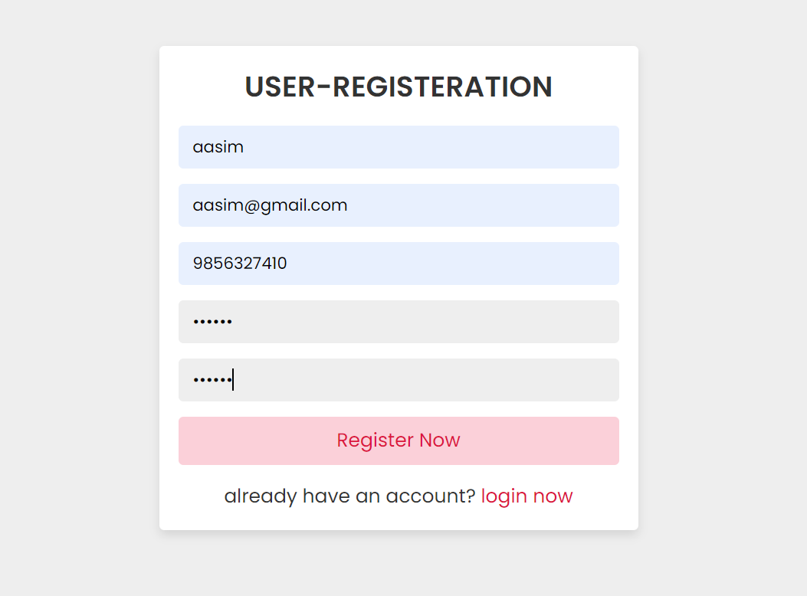
Registration-Form

Slide 11
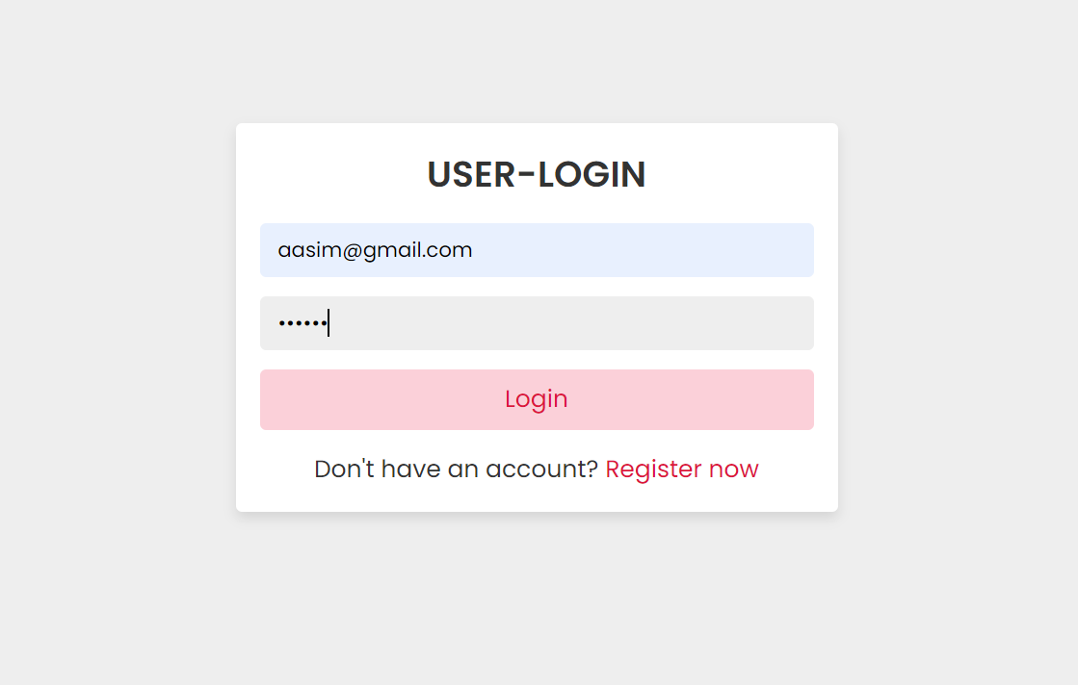
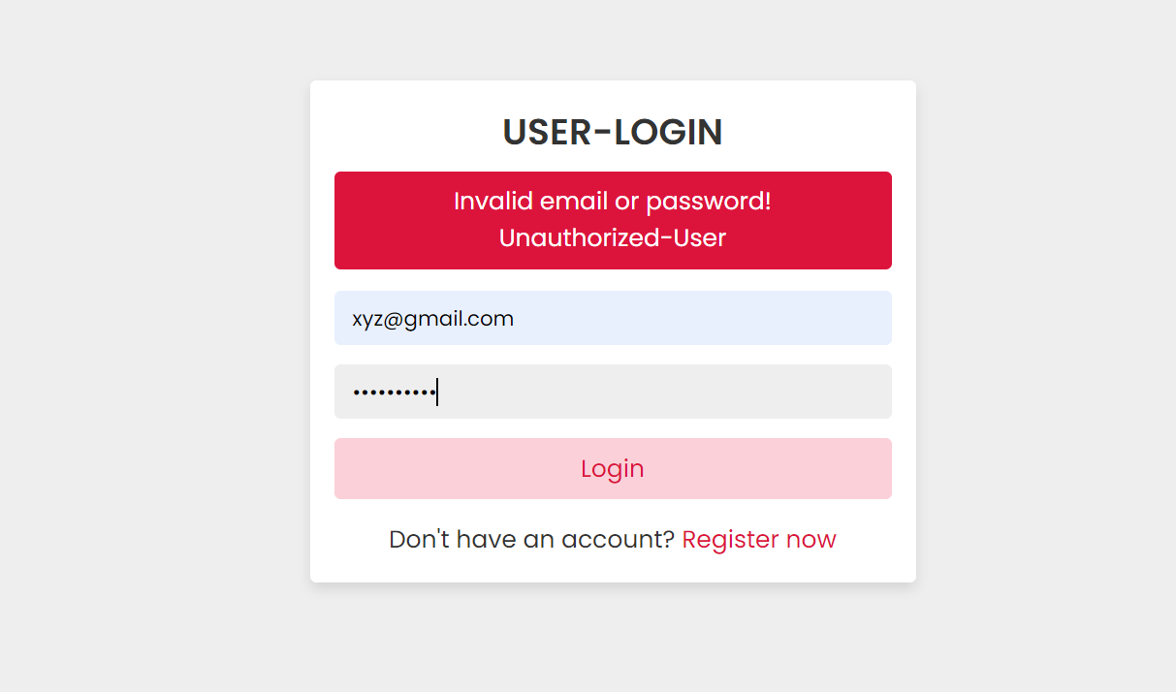
Authorized User-Login
Unauthorized User-Login

Slide 12
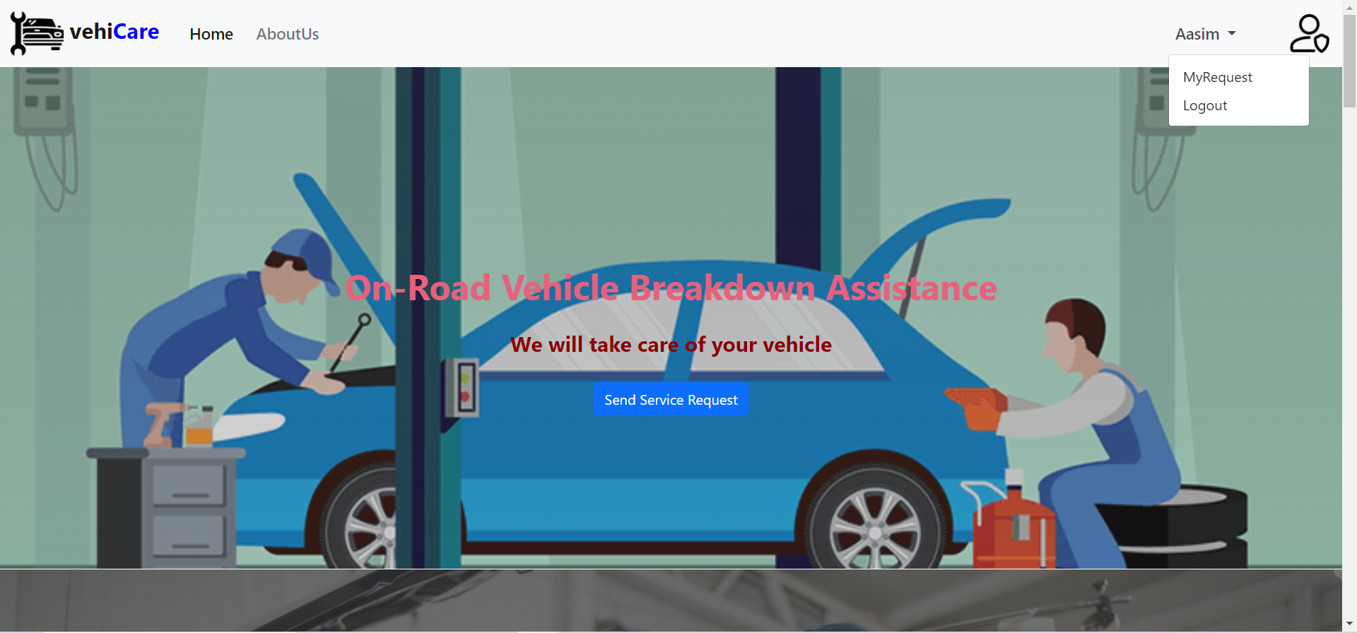

Slide 13
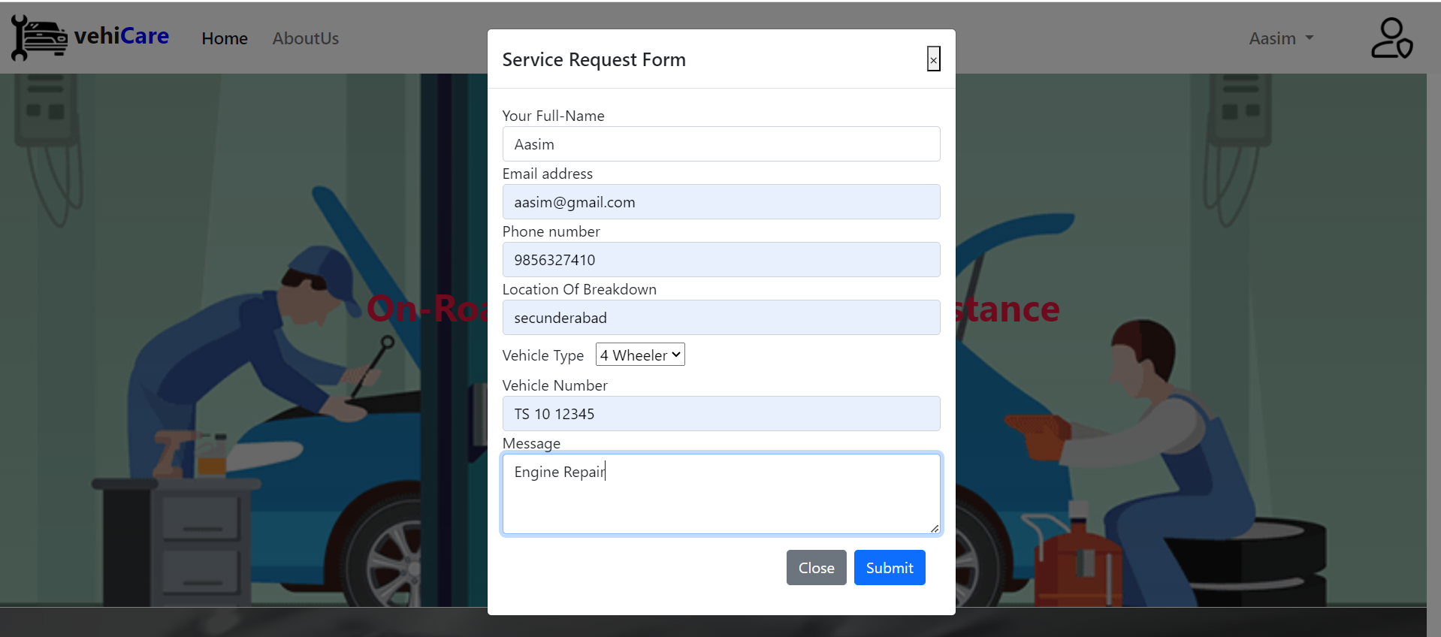
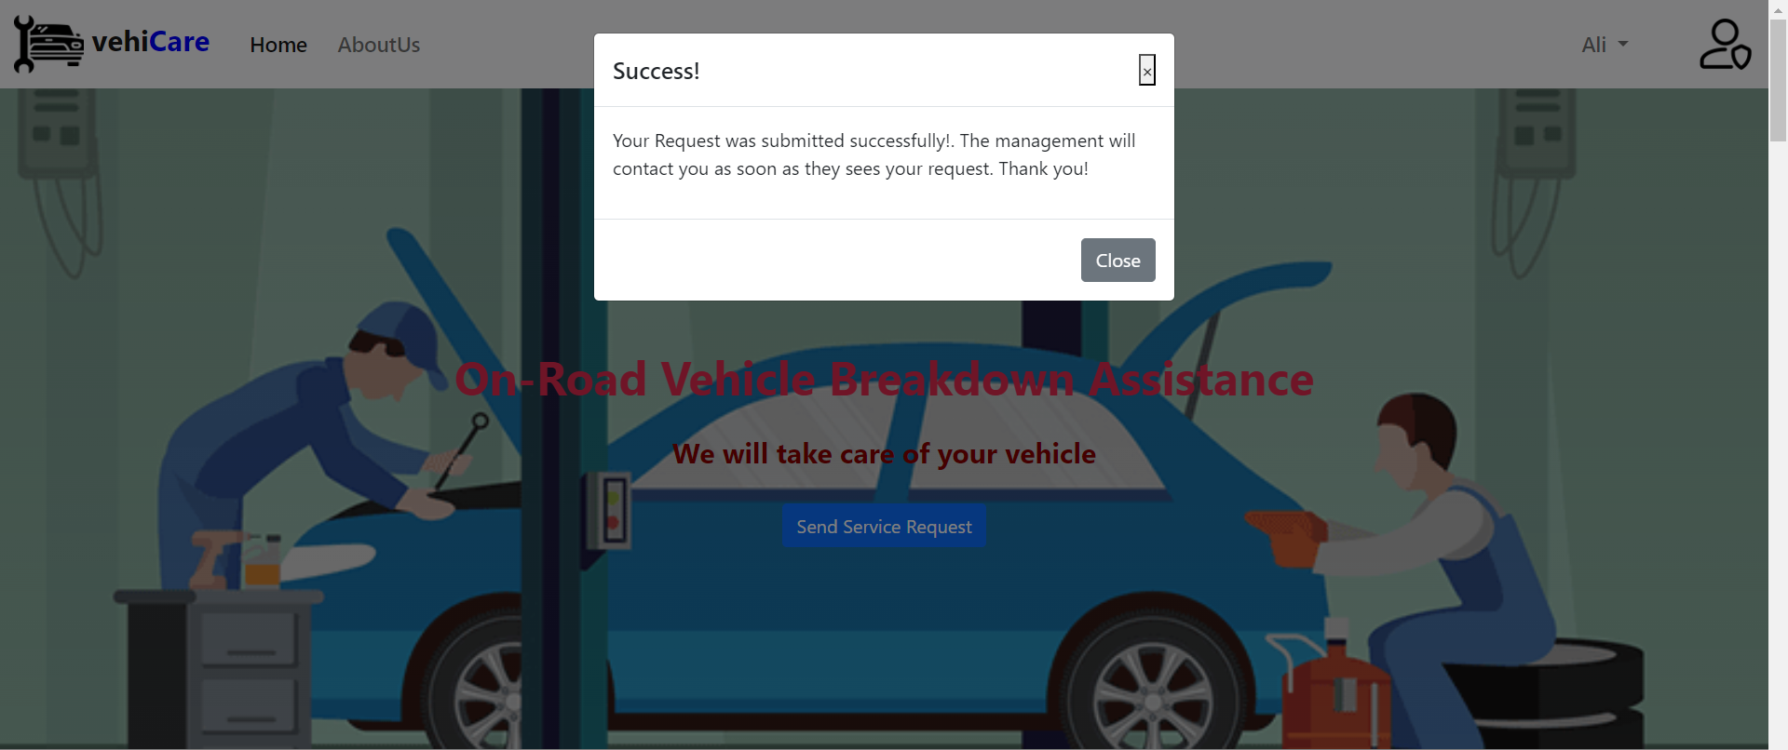
Service-Request

Slide 14
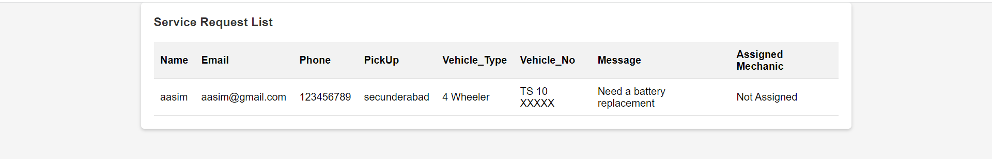

Slide 15
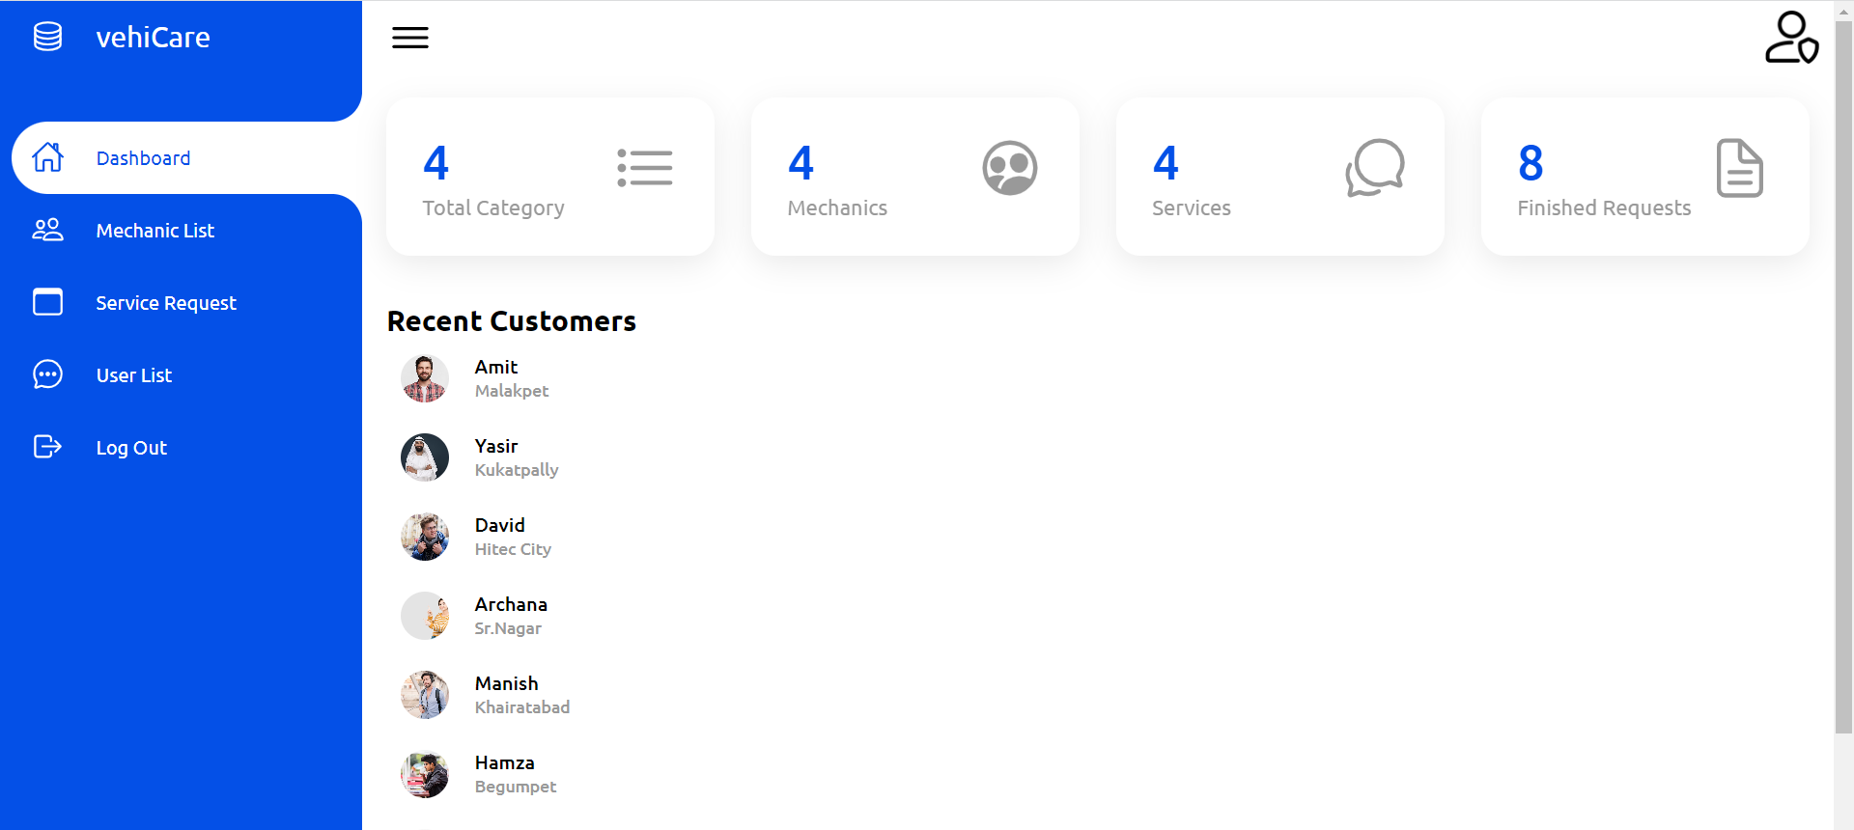
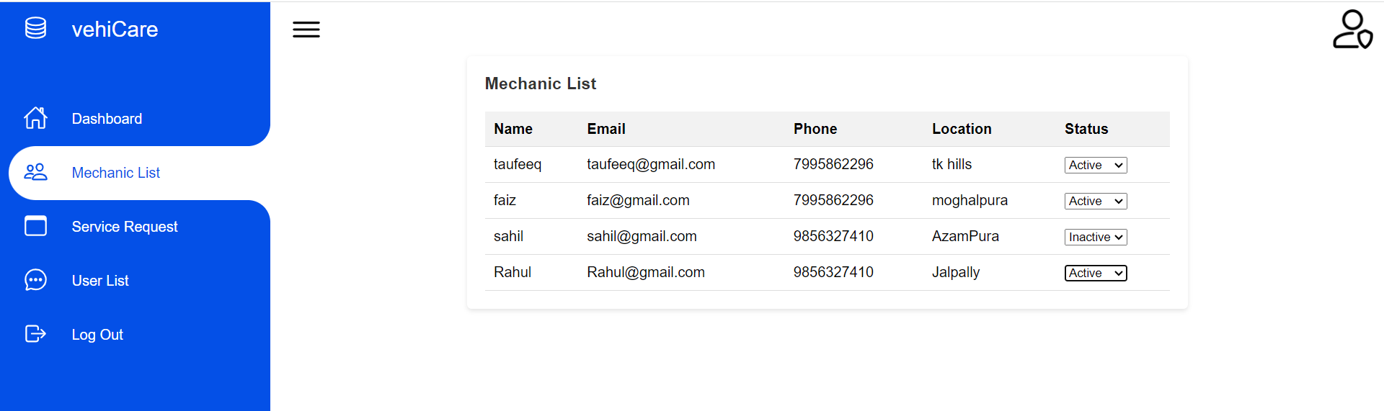
Admin Dashboard

Slide 16
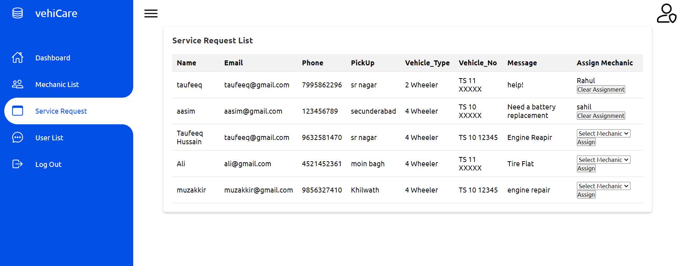
Service-Request List

Slide 17
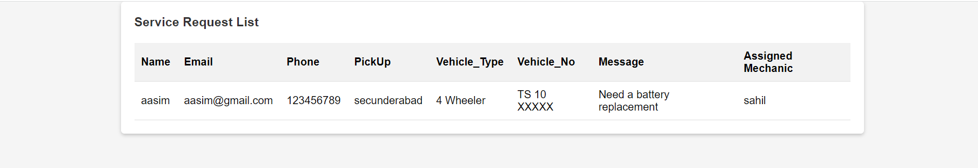
Mechanic not Assigned by Admin
Mechanic Assigned by Admin

Slide 18

Conclusion
This Platform simplifies the process of obtaining roadside assistance, connecting users with mechanics, and facilitating seamless coordination for prompt vehicle repairs.

Slide 19
THANK YOU

